Slide 1
Freelancer network
Framework
2026
Created by: Christina Totseva

Slide 2


That’s how we build trust
Welcome to the Commetric freelancer network
We don’t just deliver reports - we inform decisions
Your work directly impacts how clients understand media and act on it
We operate to high standards:
accuracy, clarity, responsiveness, and on-time delivery

Slide 3
Our 7-pillar freelancer model
Standardized onboarding & guides
Skills-based assignment model
Tiered talent structure
Continuous feedback &
QA loop
Collaboration
& workflow platform
Community & incentives
Performance data & quality metrics

Slide 4
Pillar 1: Standardized onboarding & guides
To eliminate uncertainty and provide structure for best performance
We provide clear quality guidelines, examples, templates, and defined expectations Every project is supported by documented standards to ensure consistency, transparency, and shared understanding across the network.
Project briefs outline scope, priorities, and client requirements Project briefs outline scope, priorities, and client requirements
Style guides and QC checklists create consistent quality standards These tools are provided to support you in meeting client expectations and minimizing revisions.
Structured onboarding ensures alignment from day one You receive the necessary information, access, and guidance so that expectations are clear and performance standards are transparent.

Slide 5
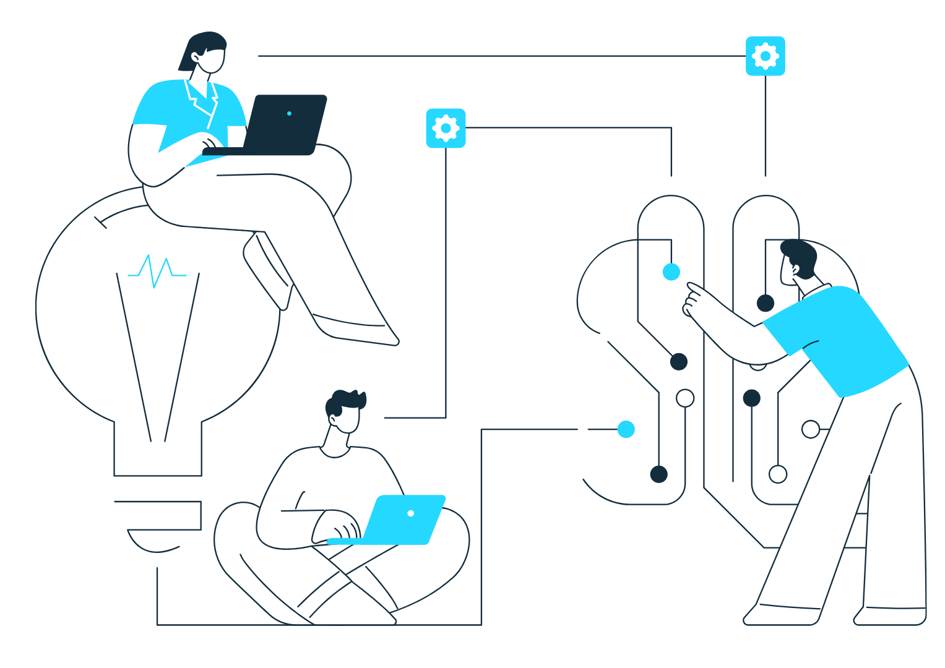
Pillar 2: Skills-based assignment model
Work is mapped to a defined skills and experience matrix.
Assignments are allocated based on demonstrated capabilities, prior performance, and project complexity. This ensures the right level of expertise is matched to the right task.
Industry familiarity is considered.
Experience within relevant sectors (e.g., finance, healthcare, tech, public policy) improves contextual understanding, terminology accuracy, and analytical depth.
Language proficiency is considered.
Assignments requiring nuanced interpretation, high-quality summaries, or client-facing language are matched to freelancers with strong written fluency and editorial precision.
Tool familiarity is considered.
Experience with platforms such as Signal, Cogent, Meltwater, and similar monitoring tools improves efficiency and reduces onboarding time for complex briefs.
Task complexity is matched to skill level.
Not all tasks require the same level of analytical depth:
    Snippet selection and tagging require precision, attention to detail, and correct application of inclusion/exclusion criteria.
    Headline summaries and analytical write-ups require stronger synthesis skills, contextual understanding, and structured writing ability.
    More complex narrative or thematic summaries are assigned to freelancers with proven analytical and writing capability.

Slide 6

Pillar 3: Tiered talent structure
The tier system ensures that complexity is matched to capability — protecting quality while creating clear growth opportunities.
Tier 1 – Expert Proven high QA scores and strong analytical capability Handles complex briefs, nuanced summaries, and narrative synthesis May support onboarding or act as a quality reference point for others Trusted with high-sensitivity or high-visibility client work
Progression Criteria
  Movement between tiers is performance-based and data-informed. Key factors include:
    Sustained QA scores and low revision rates
    Consistent on-time delivery
    Responsiveness and shift reliability
    Demonstrated ability to apply feedback
    Positive client or PM feedback
  Progression reflects demonstrated capability - not tenure alone.
Tier 2 – Solid Contributor Demonstrated consistent QA performance and delivery reliability Handles standard newsletter production and structured summaries Requires minimal supervision Escalates risks appropriately and applies feedback consistently
Tier 3 – New / Trial Recently onboarded or new to a specific project Assigned lower-complexity tasks (e.g., snippet selection, tagging, basic formatting) Work may be reviewed more closely during the initial phase Focus: accuracy, adherence to guidelines, and reliability

Slide 7
Pillar 4: Continuous feedback & QA loop
All work is reviewed using structured quality rubrics We assess accuracy, relevance, clarity, adherence to client instructions, and overall analytical quality to ensure consistent standards across the network.
Lead Analysts and Project Managers provide structured, actionable feedback Feedback is expected to be reviewed immediately, carefully and implemented in the next planned deliverable (future deliverables). Repeated issues that are not addressed may impact work allocation and progression.
Risks must be escalated immediately If you identify ambiguity, missing data, technical issues, or time risks, inform the PM or Lead Analyst at once. Early escalation protects delivery and client trust.
Silence is treated as non-availability If you are unreachable during your shift or fail to respond to critical messages, we assume you are unavailable and may reassign the work to protect deadlines.

Slide 8
Pillar 5: Collaboration & workflow platform
Use your Commetric email and Microsoft Teams for all project communication Client instructions, updates, and operational messages must be handled through official channels to ensure traceability and accountability. Personal email or informal channels should not be used for project work.
Log all worked time accurately and promptly in Aladdin Time must be recorded after each deliverable and before month-end. Accurate timesheets are essential for transparency, billing integrity, and ongoing collaboration. Projects have predetermined time for preparation, which is the benchmark and the goal to meet and improve on.
Confirm written instructions before acting on them When receiving specific client or PM instructions (inclusion/exclusion of stories, new Client requirements, format changes, priority shifts), acknowledge in writing that you have read and understood them. This prevents misalignment and rework.
Ensure all required tools and access are ready before your shift starts Platform access (Signal, Cogent, Meltwater, etc.), internet stability, and login credentials must be checked in advance. Production time should not be spent resolving preventable access issues. It is a good idea to have a backup plan for potential situations with internet or power instability, computer failure, etc. in order to prevent such situations affecting your planned workflow.

Slide 9



Pillar 6: Engagement through community & incentives
Microsoft Teams community and recognition
Our Teams channels are not just operational spaces - they are where updates, best practices, clarifications, and recognition are shared. Strong contributors are acknowledged and visible within the network.
Priority access to briefs for reliable freelancers
Consistent performance, strong QA results, and dependable attendance lead to earlier access to new projects, more stable workload allocation, and involvement in higher-complexity assignments.
Clear growth pathways and long-term collaboration
Freelancers who demonstrate quality, responsiveness, and ownership progress through tiers, gain more responsibility, and build long-term working relationships with project teams.

Slide 10
Pillar 7: Performance data & quality metrics
Performance data ensures decisions about allocation, progression, and rates are objective and merit-based.
On-time delivery Deliverables must be submitted at the agreed time. Consistent punctuality demonstrates reliability and protects client trust. Repeated delays may impact future work allocation.
Revision rates We track how often deliverables require corrections or rework. Low revision rates indicate strong understanding of briefs, adherence to guidelines, and analytical accuracy.
QA scores Output is evaluated against structured quality criteria, including accuracy, relevance, clarity, adherence to client instructions, and consistency with the style guide. QA scores inform tier progression and workload allocation.
Responsiveness and attendance reliability Timely replies to PM and client instructions, confirmed shift starts, and consistent attendance for agreed shifts are key indicators of professionalism and dependability
Performance metrics will be updated monthly and accessible via Commetric’s freelancer platform. The performance will be accompanied by a feedback session.

Slide 11
Non-negotiables
Start on time
Be online and ready to begin work at the agreed shift start. Send your start confirmation message before commencing. Production time must not be reduced by late logins or preparation delays.
Deliver on time
All deliverables must be submitted at the agreed deadline. If a timing risk emerges, escalate immediately - do not wait until the deadline has passed.
Follow the brief
Every output must comply with the approved project style guide and client instructions. Consistency in formatting, tone, structure, and tagging is part of quality delivery.
Escalate immediately if issues arise
Technical problems, unclear instructions, workload risks (more articles than usual), or personal emergencies must be communicated to the lead analyst/PM without delay. Early escalation protects the client and the team.
Log hours accurately
Record all worked time promptly and truthfully in Aladdin. Timesheets must reflect actual work completed and be submitted before month-end.

